Slide 1
Image Caption Generation Using External Knowledge
Adish Rajendra Kerkar (211IT0)
Chikkeri Chinmaya (211IT017)
Manjunath Harale (211IT023)

Slide 2
Problem Statement
Objectives
Enhance image captioning by integrating external knowledge from online sources, generating richer, contextually informed captions beyond simple visual descriptions.
Detect key objects in images to guide knowledge retrieval.
Retrieve relevant information from online sources based on detected objects.
Combine visual features and external knowledge using a multi-modal model.
Generate enriched captions with enhanced context and detail.
Evaluate captions for relevance, accuracy, and informativeness.

Slide 3
Dataset
The Flickr 8K dataset consists of 8,000 images, each paired with five human-generated captions describing the content. It is used primarily for image captioning and multimodal learning, where models generate textual descriptions from images. The dataset covers a wide range of categories, including animals, landscapes, and people.
Key Features:
8,000 images with 5 captions per image.
Used for training models to generate captions and understand both images and text.
Commonly split into training (6,000), validation (1,000), and test (1,000) sets.
Applications:
Image Captioning: Combining CNNs for image features and RNNs or Transformers for generating text.
Multimodal Learning: Learning joint representations of images and text.

Slide 4
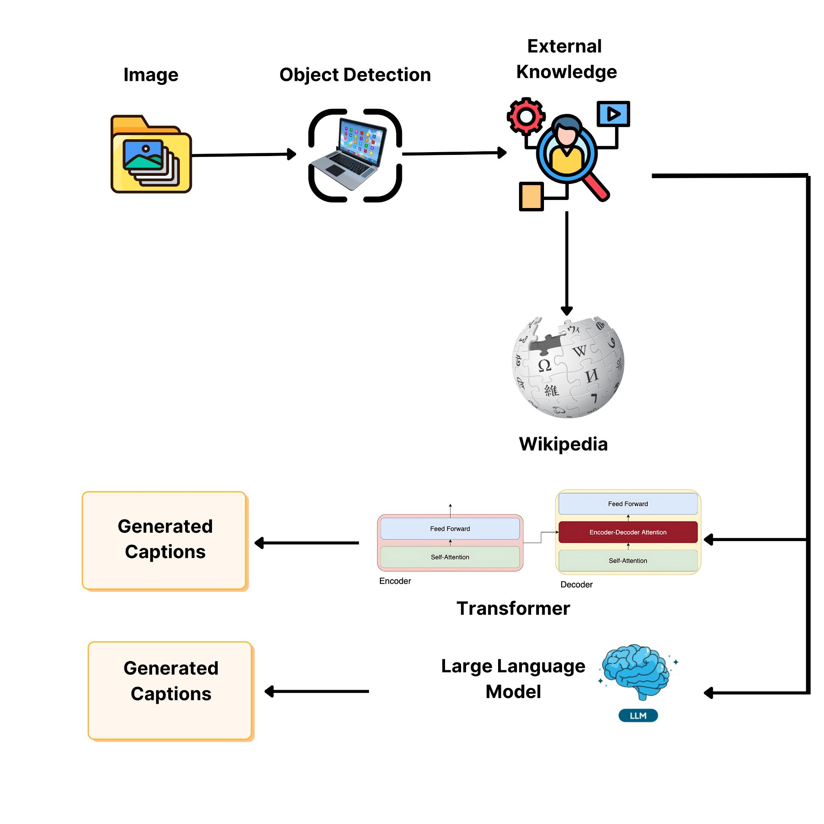
System Architecture

Slide 5
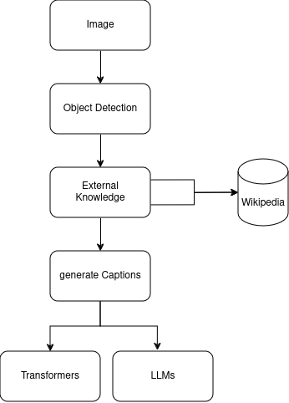
Methodology

Slide 6
Methodology
Image Input and Preprocessing
The pipeline begins by accepting an input image. This image is preprocessed, typically resized and normalized, so that it can be used by the object detection model.
Object Detection
A pre-trained object detection model, such as YOLO (You Only Look Once), identifies and labels key objects within the image.
The detected objects provide keywords that represent the main elements in the scene.
These keywords serve as anchors to find relevant external information, as they help identify what knowledge would be contextually useful for describing the image.

Slide 7
Methodology
External Knowledge Retrieval
Using the keywords from the object detection step, an API call is made to retrieve relevant information from external sources, such as Wikipedia.
For example, if the detected objects are "dog" and "Frisbee," the system searches for concise information on these topics, e.g., “Dogs often play with Frisbees in parks,” instead of long or detailed entries.
Text filtering or summarization techniques can be applied to keep only the most relevant facts, reducing the retrieved text to key details that will help enrich the caption.
Caption Generation
We are then using encoder decoder model to generate the caption
We are also using LLms to generate the captions

Slide 8
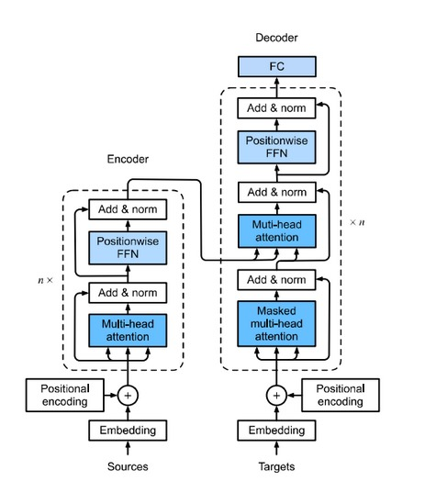
Model Architecture

Slide 9
Model Architecture
Input Sequences:
inp (input sequence), tar (target sequence).
Positional Encoding:
Add positional encodings to the input and target sequences.
Encoder Process:
Self-attention with input (inp).
Feed-forward network.
Repeat for num_layers layers.
Output: enc_output.

Slide 10
Model Architecture
Decoder Process:
Masked self-attention on target sequence (tar).
Attention over encoder output (enc_output).
Feed-forward network.
Repeat for num_layers layers.
Output: dec_output.
Final Layer:
Apply final dense layer to dec_output to produce logits over target vocabulary.
Return Outputs:
Return the final predictions (final_output) and attention weights for analysis.

Slide 11
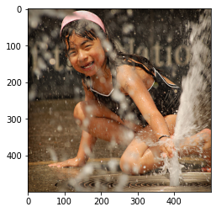
Results
BLEU-1 score: 37.5
BLEU-2 score: 61.237243569579455
BLEU-3 score: 74.5091107671223
BLEU-4 score: 78.25422900366436
Real Caption: young girl is playing in fountain of water
Predicted Caption: young boy plays in the water without shirt

Slide 12
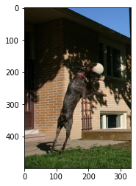
Results
BLEU-1 score: 38.94003915357025
BLEU-2 score: 55.06953149031838
BLEU-3 score: 63.25828023338613
BLEU-4 score: 65.48907866815301
Real Caption: dog leaps to catch ball
Predicted Caption: dog catches ball outside

Slide 13
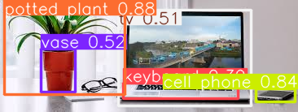
Result
Based on the detected objects in the image, it is likely that the scene takes place indoors, possibly in a living room or home office. The presence of a potted plant suggests an indoor environment, as houseplants like aloe vera or snake plants are commonly found in such spaces. Additionally, the visible cell phone indicates a location where people frequently use phones, such as a living room or office. These elements together point to a domestic or office-related setting, with the plant and phone providing clues about the location's functionality and atmosphere.

